Slide 1


Ceng Ludo
The project is a game.
Hilal ÇEPİK
Emre Berk ALGÜL
Oğuz Kağan EREN

Slide 2


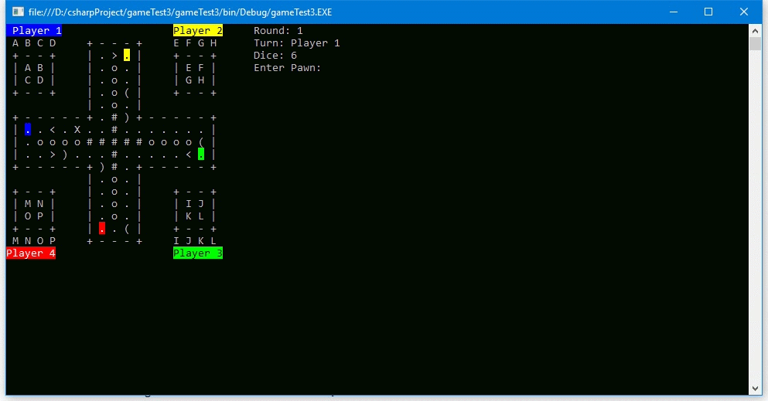
Content
1
1
2
Description of the game
3
Artificial intelligence
Problems encountered

Slide 3
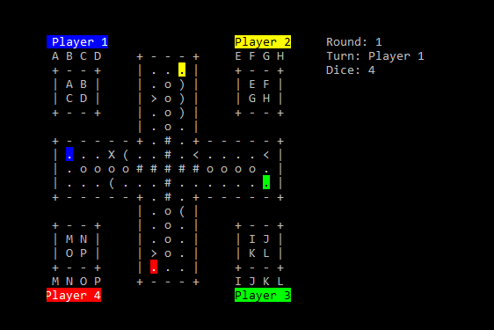
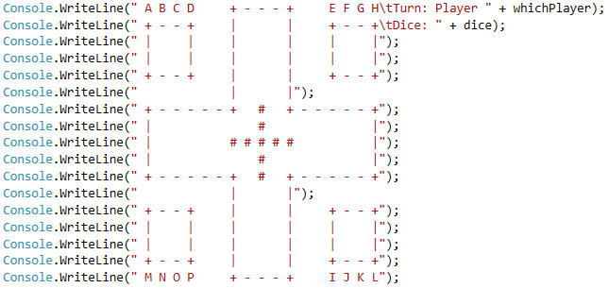
How to play the game?
2

Slide 4
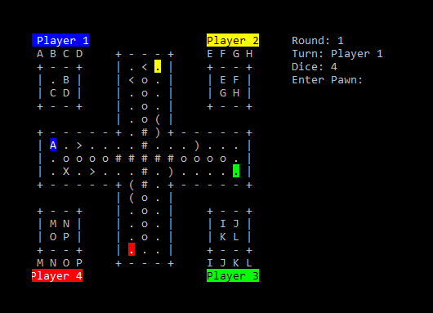
Playing Section
3
“ ) ” | Go 3 steps forward
“ > ” | Play one more time
“ ( ” | Go 3 steps back
“ < ” | Wait for one round without playing
“ X ” | Go back to the starting point

Slide 5
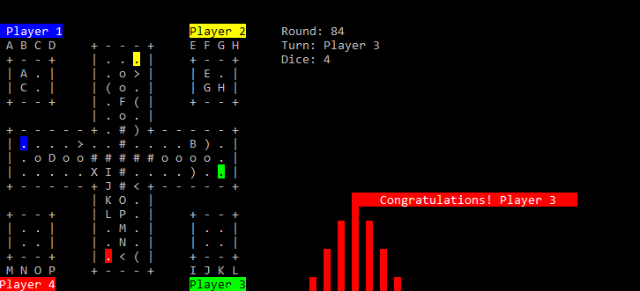
Finishing Section
4

Slide 6
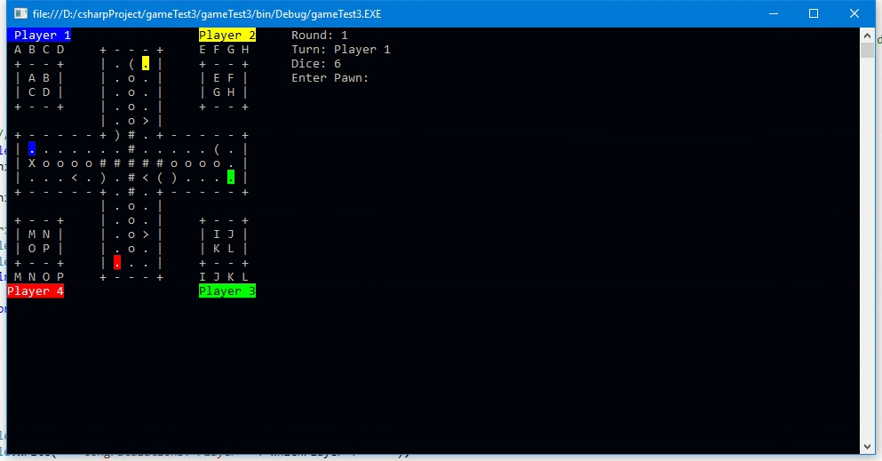
Artificial Intelligence
5

Slide 7

Order Of Precedence
6
Rewards
Penalties
Entering the finish point
Getting other player’s pawn out
Playing one more time
Going 3 steps forward
Going forward when the target point is empty
Going 3 steps back
Waiting for one round
Going back to the starting point

Slide 8
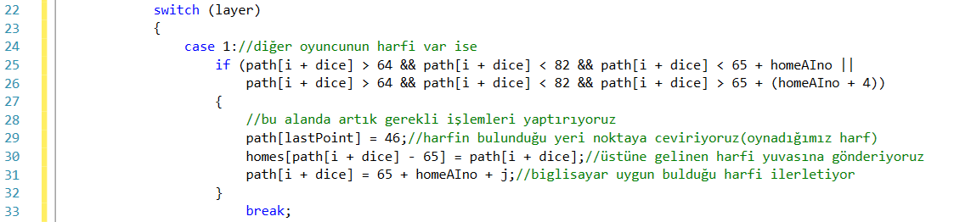
Order Of Precedence
7

Slide 9
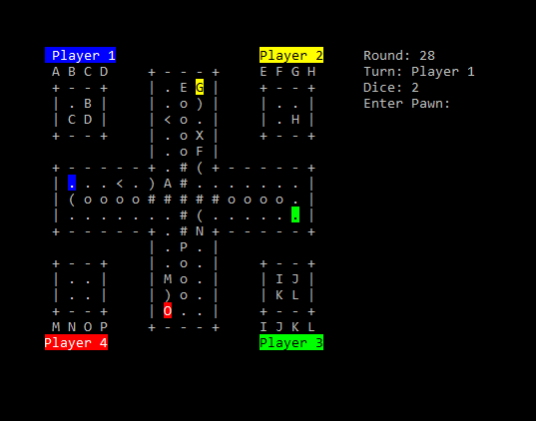
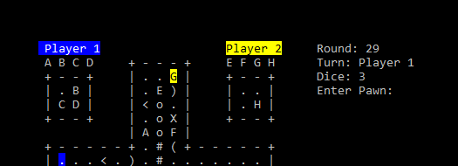

Problems encountered
8
How did we place pawns which are other players?

Slide 10
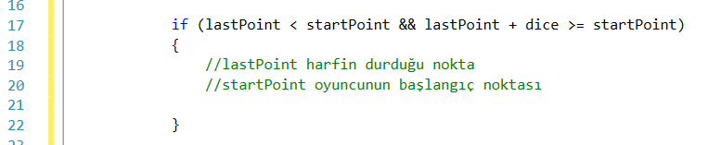
Placing pawn endpoints
9

Slide 11
Reposition of ‘<‘ or ‘>’
10

Slide 12
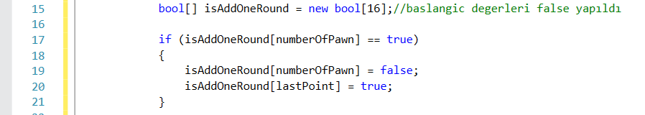
Reposition of ‘<‘ or ‘>’
11

Slide 13
Conclusion
12
1
2
The game has vivid colors.
3
AI of the game is excellent.
We offer you the best.

Slide 14
Thank you for your interest
Hilal ÇEPİK
Emre Berk ALGÜL
Oğuz Kağan EREN

